Slide 1

Chapter 20
Creating SVG Graphics

Slide 2
Learning Objectives
How to embed a graphic stored within a .SVG file in an HTML page
How to use the <svg> and </svg> tag pair to specify common SVG shapes
How to integrate text and graphics using SVG
How SVG provides advanced capabilities, including blurs, gradients, and more

Slide 3
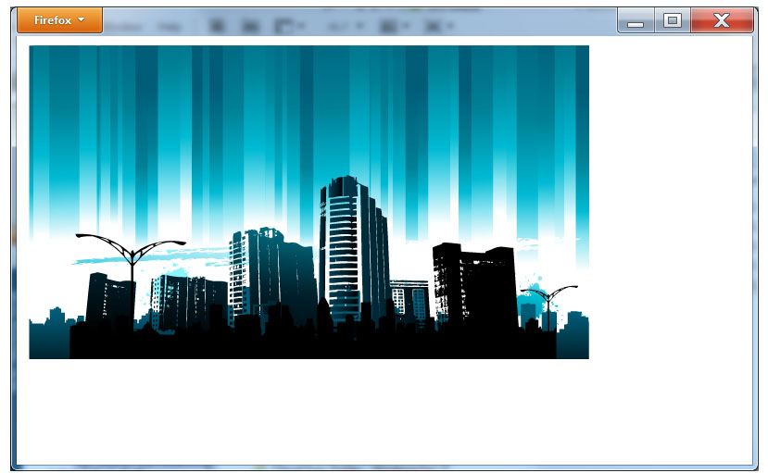
Placing an svg graphic in an html file
There are two ways to place an SVG image within a webpage. First, if you have the image stored as an SVG file, with the .SVG extension, you can use the <object> and </object> tag pair to place the image within the webpage. The following HTML file, SVGDemo.html, places an SVG image file within a page:
<!DOCTYPE html> <html> <body> <object data="http://www.websitedevelopmentbook.com/Chapter20/FirstSvg.svg" type="image/svg+xml" > <embed src="http://www.websitedevelopmentbook.com/Chapter20/FirstSvg.svg" type="image/svg+xml" /> </object> </body> </html>

Slide 4
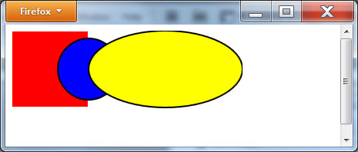
Embedding svg instructions
<!DOCTYPE html> <html> <body> <svgxmlns="http://www.w3.org/2000/svg" version="1.1"> <rect width="100" height="100" style="fill:red;stroke-width:2;stroke:white"/> <circle cx="100" cy="50" r="40" stroke="black" stroke-width="2" fill="blue"/> <ellipse cx="200" cy="50" rx="100" ry="50" style="fill:yellow;stroke:black;stroke-width:2"/> </svg> </body> </html>

Slide 5
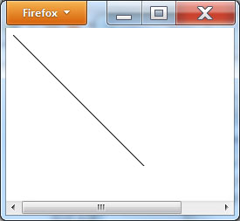
Drawing an SVG Line
<!DOCTYPE html> <html> <body> <svgxmlns="http://www.w3.org/2000/svg" version="1.1"> <line x1="0" y1="0" x2="200" y2="200" style="stroke:black" /> </svg> </body> </html>

Slide 6
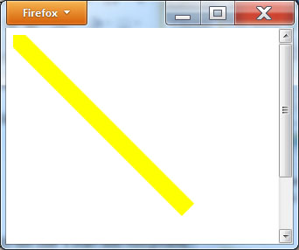
Controlling line width
<!DOCTYPE html> <html> <body> <svgxmlns="http://www.w3.org/2000/svg" version="1.1" width="300" height="300"> <line x1="0" y1="0" x2="200" y2="200" style="stroke:yellow; stroke-width:20;" /> </svg> </body> </html>

Slide 7
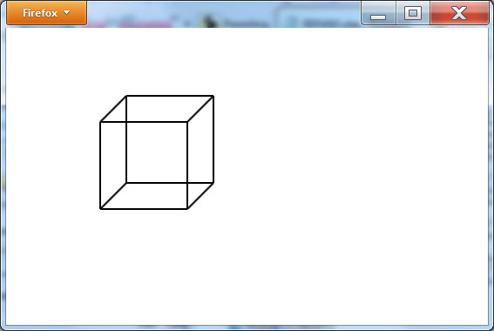
Using lines to draw a 3d cube
<!DOCTYPE html> <html> <body> <svgxmlns="http://www.w3.org/2000/svg" version="1.1" height="300" width="300"> <line x1="100" y1="100" x2="200" y2="100" style="stroke:black; stroke-width:2;" /> <line x1="100" y1="100" x2="100" y2="200" style="stroke:black; stroke-width:2;" /> <line x1="200" y1="100" x2="200" y2="200" style="stroke:black; stroke-width:2;" /> <line x1="100" y1="200" x2="200" y2="200" style="stroke:black; stroke-width:2;" /> <line x1="130" y1="70" x2="230" y2="70" style="stroke:black; stroke-width:2;" /> <line x1="100" y1="100" x2="130" y2="70" style="stroke:black; stroke-width:2;" /> <line x1="200" y1="100" x2="230" y2="70" style="stroke:black; stroke-width:2;" /> <line x1="230" y1="70" x2="230" y2="170" style="stroke:black; stroke-width:2;" /> <line x1="200" y1="200" x2="230" y2="170" style="stroke:black; stroke-width:2;" /> <line x1="100" y1="200" x2="130" y2="170" style="stroke:black; stroke-width:2;" /> <line x1="130" y1="70" x2="130" y2="170" style="stroke:black; stroke-width:2;" /> <line x1="130" y1="170" x2="230" y2="170" style="stroke:black; stroke-width:2;" /> </svg> </body> </html>

Slide 8
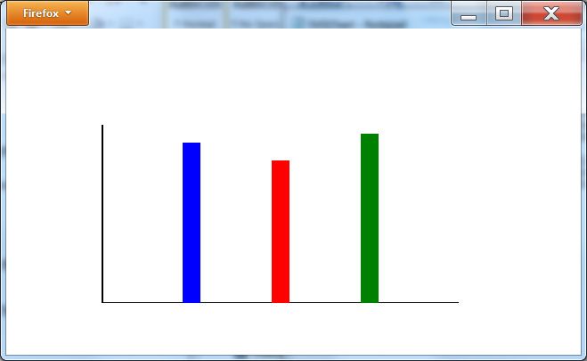
Creating a chart
<!DOCTYPE html> <html> <body> <svgxmlns="http://www.w3.org/2000/svg" version="1.1" height="300" width="500"> <line x1="100" y1="100" x2="100" y2="300" style="stroke:black; stroke-width:2;" /> <line x1="100" y1="300" x2="500" y2="300" style="stroke:black; stroke-width:2;" /> <line x1="200" y1="300" x2="200" y2="120" style="stroke:blue; stroke-width:20;" /> <line x1="300" y1="300" x2="300" y2="140" style="stroke:red; stroke-width:20;" /> <line x1="400" y1="300" x2="400" y2="110" style="stroke:green; stroke-width:20;" /> </svg> </body> </html>

Slide 9
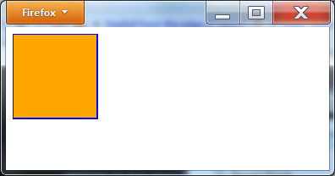
Svg Square
<!DOCTYPE html> <html> <body> <svgxmlns="http://www.w3.org/2000/svg" version="1.1" width="120" height="120"> <rect width="100" height="100" style="fill:orange;stroke-width:2;stroke:blue"/> </svg> </body> </html>

Slide 10
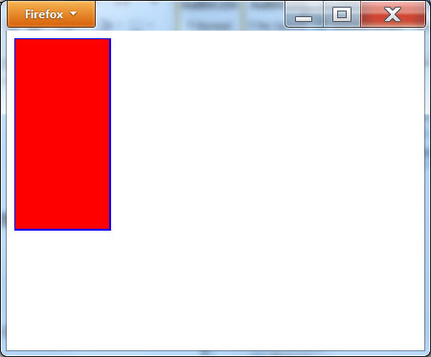
Svg rectangle
<!DOCTYPE html> <html> <body> <svgxmlns="http://www.w3.org/2000/svg" version="1.1" width="300" height="300"> <rect width="100" height="200" style="fill:red;stroke-width:2;stroke:blue"/> </svg> </body> </html>

Slide 11
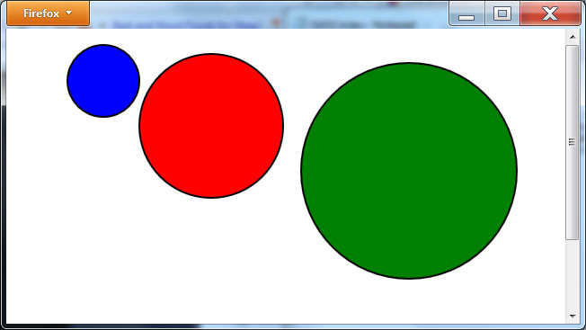
Svg circles
<!DOCTYPE html> <html> <body> <svgxmlns="http://www.w3.org/2000/svg" version="1.1" width="600" height="400"> <circle cx="100" cy="50" r="40" stroke="black" stroke-width="2" fill="blue"/> <circle cx="220" cy="100" r="80" stroke="black" stroke-width="2" fill="red"/> <circle cx="440" cy="150" r="120" stroke="black" stroke-width="2" fill="green"/> </svg> </body> </html>

Slide 12
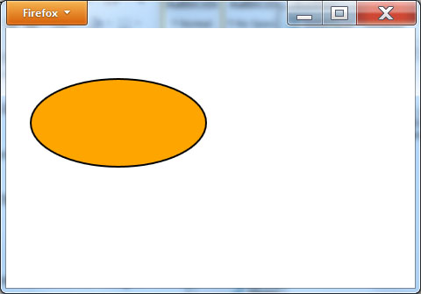
Svg ellipses
<!DOCTYPE html> <html> <body> <svgxmlns="http://www.w3.org/2000/svg" version="1.1" width="300" height="200"> <ellipse cx="120" cy="100" rx="100" ry="50" style="fill:orange;stroke:black;stroke-width:2"/> </svg> </body> </html>

Slide 13
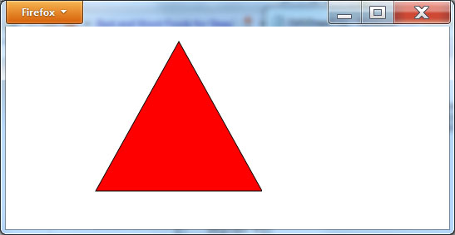
Svg polygon
<!DOCTYPE html> <html> <body> <svgxmlns="http://www.w3.org/2000/svg" version="1.1" width="300" height="200"> <polygon points="200,10 100,190 300,190" style="fill:red;stroke:black;stroke-width:1"/> </svg> </body> </html>

Slide 14
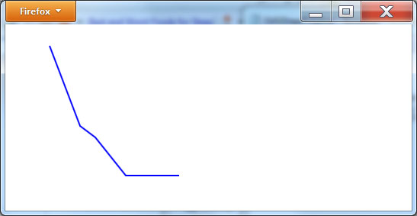
Svg polyline
<!DOCTYPE html> <html> <body> <svgxmlns="http://www.w3.org/2000/svg" version="1.1" width="300" height="200"> <polyline points="50,20 90,125 110,140 150,190 220,190" style="fill:none;stroke:blue;stroke-width:2" /> </svg> </body> </html>

Slide 15
Svg Path
The SVG <path> element lets you specify a series of movement and drawing commands:
A = elliptical Arc
C = curveto
H = horizontal lineto
L = lineto
M = moveto
Q = quadratic Bézier curve
S = smooth curveto
T = smooth quadratic Béziercurveto
V = vertical lineto
Z = closepath

Slide 16
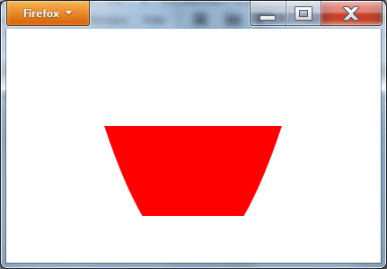
Svg path example
<!DOCTYPE html> <html> <body> <svgxmlns="http://www.w3.org/2000/svg" version="1.1" width="300" height="200"> <path d="M100,100 Q200,400,300,100" style="fill:red;stroke-width:2;stroke:white"/> </svg> </body> </html>

Slide 17
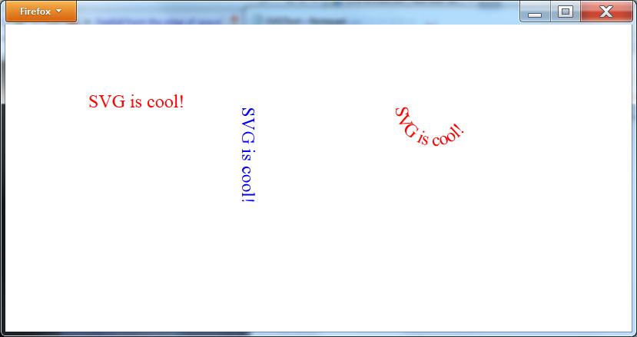
Drawing text with svg
<!DOCTYPE html> <html> <body> <svgxmlns="http://www.w3.org/2000/svg" version="1.1" width="800" height="300"> <text x="100" y="100" font-size="24" fill="red">SVG is cool!</text> <text x="300" y="100" font-size="24" fill="blue" transform="rotate(90 300,100)">SVG is cool!</text> <defs> <path id="path1" d="M500,100 a1,1 0 0,0 100,0" /> </defs> <text x="10" y="100" font-size="24" style="fill:red;"> <textPathxlink:href="#path1">SVG is cool!</textPath> </text> </svg> </body> </html>

Slide 18
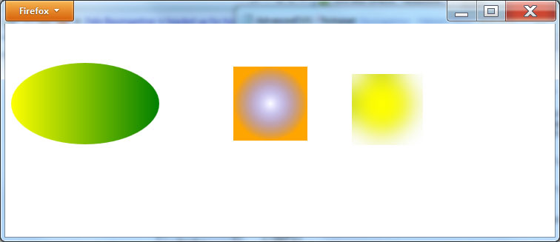
Advanced svg
<!DOCTYPE html> <html> <body> <svgxmlns="http://www.w3.org/2000/svg" version="1.1" width="600" height="200"> <defs> <linearGradient id="grad1" x1="0%" y1="0%" x2="100%" y2="0%"> <stop offset="0%" style="stop-color:Yellow;stop-opacity:1" /> <stop offset="100%" style="stop-color:Green;stop-opacity:1" /> </linearGradient> </defs> <ellipse cx="100" cy="100" rx="100" ry="55" fill="url(#grad1)" /> <defs> <radialGradient id="grad2" cx="50%" cy="50%" r="50%" fx="50%" fy="50%"> <stop offset="0%" style="stop-color:blue; stop-opacity:0" /> <stop offset="100%" style="stop-color:orange;stop-opacity:1" /> </radialGradient> </defs> <rect x="300" y="50" width="100" height="100" fill="url(#grad2)" /> <defs> <filter id="f1" x="0" y="0"> <feGaussianBlur in="SourceGraphic" stdDeviation="15" /> </filter> </defs> <circle cx="500" cy="100" r="40" stroke="green" stroke-width="3“ fill="yellow" filter="url(#f1)" /> </svg> </body> </html>

Slide 19
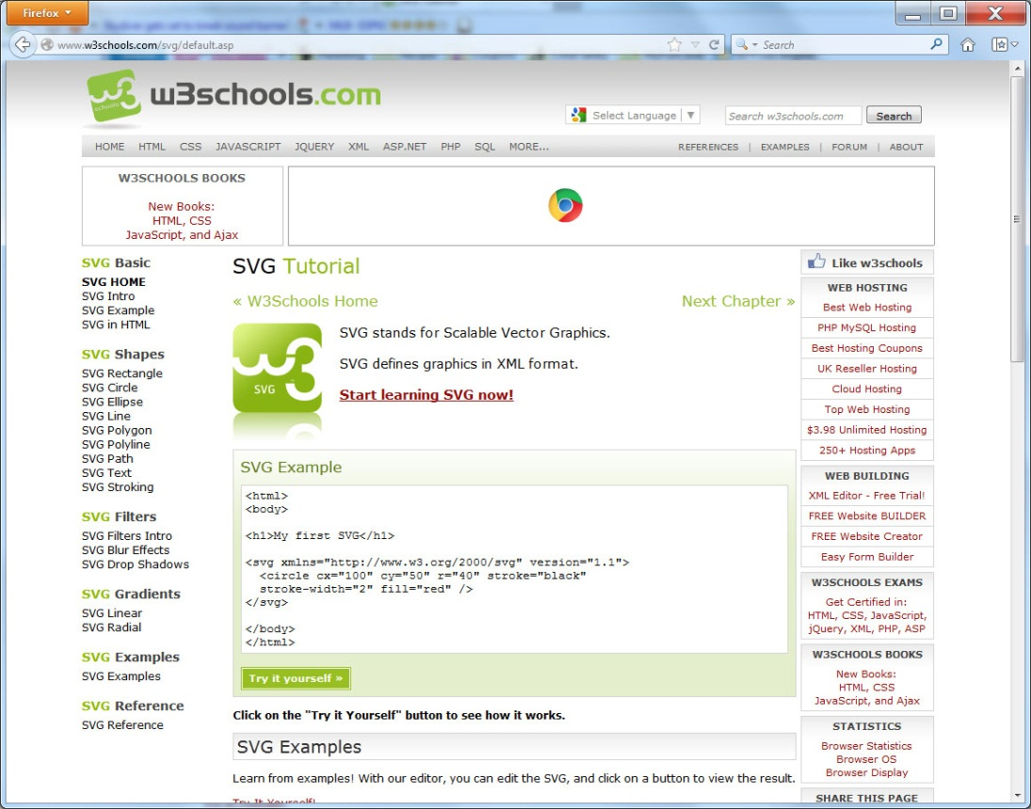
Real World: w3schools

Slide 20
summary
Scalable vector graphics (SVG) are unique in that they do not loose quality when you scale them.
Unlike pixel-based graphics that contain specific color values for the dots that make up an image, an SVG graphic contains XML-based instructions the browser uses to render the graphic.
Because SVG graphics do not work in terms of dots, the browser can easily scale them. This chapter introduced the use of SVG graphics within a webpage.
You can embed an existing .SVG file within a webpage or, using the <svg> and </svg>, you can place the actual instructions that draw the graphic.

